Slide 1
Staying safe online in
Climate Education Spaces
Mohamed Elmustafa Omer / Cyber security student

Slide 2

Why this matters ?
Protecting digital environment:
Protect your privacy and personal information.
Keep your climate voice secure and active.
Prevent disruption to your important activism work.
Maintain mental wellbeing by avoiding harassment.
Key Quote: “Just like we protect our environment, we need to protect our digital spaces.”.

Slide 3

Common Online Risks
Know the Risks:
Phishing: Fake messages pretending to be trusted sources.
Misinformation: False climate data or misleading “solutions”.
Account Hacking: Unauthorized access to your social media..
Impersonation: Fake accounts pretending to be climate organizations.
Malware: Harmful software hidden in downloads

Slide 4
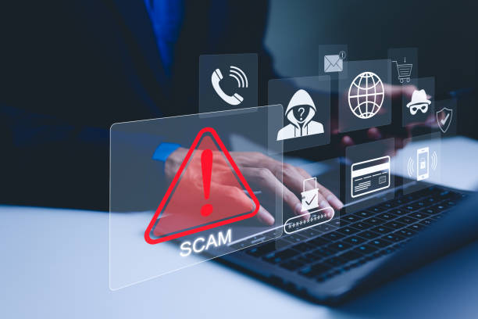
Real-Life Examples
What to Watch For:
The “FridaysForFuture” Scam An email asking you to click a link to vote for an action, leading to a fake login page.
Too Good to be True: Messages claiming a “simple device reduces CO2 by 90%”.
The Fake Documentary: DMs asking for personal stories to gain your trust and eventually your data.

Slide 5
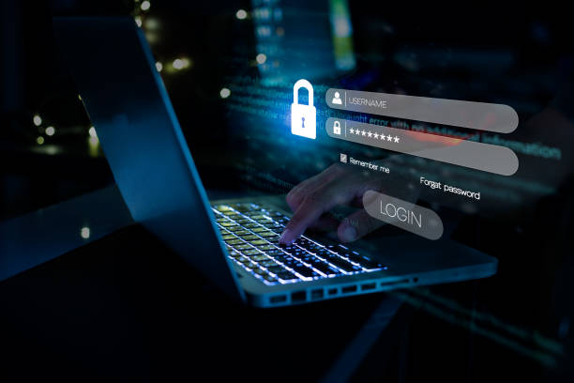
Password & Account Safety
Strengthening Your Digital Shield:
Strong Passwords: Use 12+ characters; never reuse passwords across sites.
Password Managers: Use tools like Bitwarden to store unique keys..
Two-Factor Authentication (2FA): Add a phone code step when logging in.
Checkups: Use haveibeenpwned,com to check for data breaches.

Slide 6
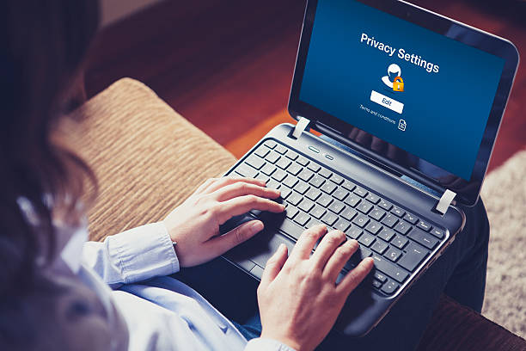
Social Media Safety
Safe Social Media for Activists:
Privacy Settings: Review monthly who can see your posts and messages.
Separate Accounts: Maintain a personal account for family and a public account for climate work.
Location Sharing: Turn off real-time location , especially at protests.
Harassment: Block and report; document the messages but do not engage with trolls.

Slide 7

Spotting Misinformation
Fact-Checking the Climate:
Check the Source: Verify if it id a reputable science organization or known institution.
Look for Dates: Ensure the science is current and not outdated.
Watch for Emotion: Be wary of content designed to make you angry without evidence.
Verify with Experts: Cross-check with NASA,IPCC, or NOAA.

Slide 8

When Things Go Wrong
Emergency Steps:
Hacked? Use “Forgot Password” immediately an contact platform support.
Phished? Change passwords on all accounts with similar logins and enable 2FA.
Threatened? Document everything and report to authorities if serious.
Overwhelmed? Digital safety includes mental health; step away when needed.

Slide 9
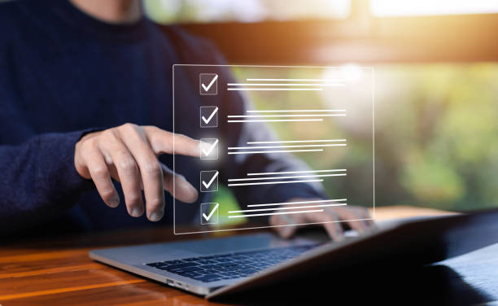
Resources & Checklist
Your Safety Checklist:
Checklist
2FA enabled
Unique passwords used
Privacy settings reviewed
Key Resources:
Digital Defense Fund (digitaldefensefund.org).
EFF’s Surveillance Self-Defense (ssd.eff.org).
AccessNow Helpline (accessnow.org/help).

Slide 10
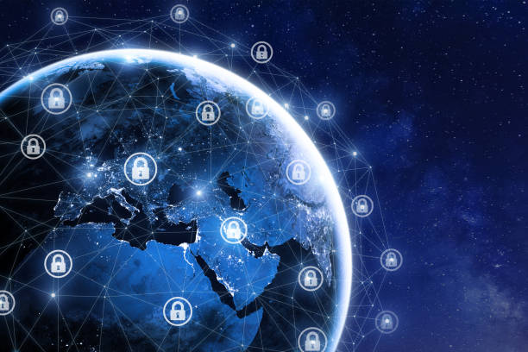
Closing & Call to Action
Safe Online = Strong Climate Action.
Together, we can build safer online environments to support our planet
Contact: https://forms.gle/MCD3JDnH9ZKcPzpQA

Slide 11
Stay safe
Bye

